Slide 1

Boot Camp : PM and Dev
Dallas GiveCamp 2016
WIFI Password- 12345123451234512345123451

Slide 2
Agenda
Welcome
GiveCamp Opening
Charity Overviews
PM Handbook & Role Overview
Dev Handbook & Role Overview
WordPress Walkthrough
Key Dates, Next Steps and Q&A

Slide 3
Welcome
Event Staff Intros:
Jake, Kate, Ryan, Alex, Dave, Joey, Rutu, Shawn and Patrick
PM & Dev Intros:
How many years at GiveCamp?
For any questions please email:
PM@dallasgivecamp.org

Slide 4
GiveCamp Overview
#1 Goal is to help charities!
Last year we donated 5k hours worth over $650,000 while helping 19 charities!!
Majority of the work will happen over 1 weekend
Prep work required and expected
Team members include:
Charity Reps, Designers, Developers and Testers
PM’s are the coach, cheerleader, facilitator and overall glue for the team
Dev’s create, deliver, and educate
Final presentations of finished product occur the Sunday afternoon of Event Weekend
Projects are complete at the end of the weekend

Slide 5
Charities
What it is all about!

Slide 6

Mission: Allies in Service's mission is to identify and support veterans who need assistance in the areas of employment, housing, education, and health care. We partner with veterans, employers, community and other veteran support organizations to educate and enhance the quality of life of our veterans.
Need: Application process enhancements
Charity Representative: David Whitley
PM: Govind Vadvadgi
Designer:
http://www.alliesinservice.org

Slide 7
Mission: Every year thousands of dollars of scholarship money that is not applied for, while at the same time students are scrambling to pay for school. What if we inverted this process and had a dedicated site where students submit (with names masked) their resumes, grades, college essays, schools applied to and their dreams and donors from around the world could donate to their students of choice. Donors could support dream big or small from college applications, books, site visits, tuition, room and board, travel abroad and more.
Need: Public Website Creation
Charity Representative: Laura Hayes
PM/Designer: Ashley Crutcher
Bridge to Tomorrow

Slide 8
Brown Sugar Babies
Mission: Brown Sugar Babies is a transitional living facility for teen mothers that aims to prepare young mothers with pertinent life and career skills to achieve success. While in the program, participants are required to take life skills courses, complete high school, explore secondary education and explore various career opportunities through mentor and internship programs.
Need: Public Website Creation
Charity Representative: Roschanda Fletcher
PM: Marta Soncodi
Designer:

Slide 9
Mission: To reduce the number of failing startup nonprofit organizations by providing resources, training and tools that are designed to scale, encourage collaboration and sustain impactful programs and services.
Need: Membership program and a way to track payments, benefits and classes.
Charity Representative: Kimberly O'Neil
PM: Michael B
Designer:
Cause Studio

Slide 10
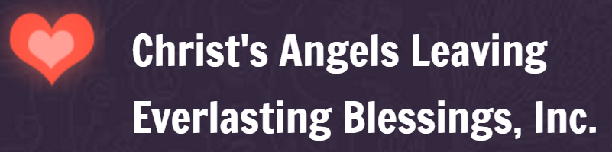
Mission: CALEB's mission is to serve, inspire, and empower individuals and Families who are affected by cancer by letting each survivor know that they are not fighting alone, that we are there with them from diagnosis and beyond.
Need: Volunteer contact process and website updates
Charity Representative: Charlotte Washington
PM: Kasandra Bell
Designer:
http://www.calebforyou.org/

Slide 11
Community of Helping Hands
Mission: Giving to the community youth and disabled
Need: Public Website Creation
Charity Representative: Ronethia Miller
PM: Courtney Ellice
Designer:

Slide 12

Dallas Police Youth Foundation
Mission: To support the youth outreach efforts of the Dallas Police Department as they engage and mentor our kids to become future community leaders.
Need: Program Tracking Database
Charity Representative: Crista Walker
PM: Mohan Tammana
Designer:
http://www.dallaspoliceyouthfoundation.com/

Slide 13
Develop University
Mission: To help young men develop integrity, responsibility and leadership, by introducing, or re-introducing, them to proven character traits and allowing them to nurture, polish and fine tune these traits in a collaborative peer atmosphere.
Need: Public Website Creation
Charity Representative: Alexis Pratt
PM/Designer: Heather Zacny

Slide 14

Mission: To make the world a better place right now and for generations to come by providing a “hand up” to responsible, gifted, hardworking individuals in need of temporary assistance who have the values, commitment, and power to create opportunity for themselves and others.
Need: Electronic mentor application and tracking process
Charity Representative: Jessica Koss
PM: Bonni Crisfulli
Designer:
http://www.foundationforchoice.org/

Slide 15

Mission: To create mentoring connections between high school students and at-risk elementary school students. The vision is to expand the ministry beyond the local community – making it possible for Just One Starfish mentoring to develop in other communities.
Need: Mentor application updates
Charity Representative: Erin Jackson
PM: Dennis Jackson
Designer:
http://justonestarfish.org

Slide 16

Mission: LHT is a nonprofit legal service, that provides free legal assistance to individuals who are terminally ill or living with HIV disease with health related legal issues.
Need: Electronic Intake Form
Charity Representative: Pete Flores
PM: Sheena Pabari
Designer:
http://legalhospice.org

Slide 17

Mission: Lovepacs exists to be an expression of God's love by engaging our communities to serve children in need
Need: Online volunteer liability waiver form
Charity Representative: Ryan Hobbs
PM:
Designer:
http://lovepacs.org/

Slide 18

Mission: To raise and donate money to help fund cancer research, education, awareness, and patient support for the cancers that affect children, adolescents and young adults and their families.
Need: Current events page and event registration easy setup
Charity Representative: Sharon White
PM: Jeremy Stewart
Designer:
http://Micaelasarmyfoundation.org/

Slide 19
Sea Turtle Conservancy
Mission: To ensure the survival of sea turtles within the Caribbean, Atlantic and Pacific through research, education, training, advocacy and protection of the natural habitats upon which they depend.
Need: Website Content Updates
Charity Representative: Dan Evans
PM: Chris Rajczi
Designer:
http://www.conserveturtles.org

Slide 20
The HUB Space
Mission: To transform and empower the undeserved start-up and business community through economic empowerment of Women & Minority owned Enterprises and Historically Underutilized Businesses in the North Texas area by providing coaching, mentoring, start-up resources, work space and information about access to capital.
Need: Public Website Creation
Charity Representative: Scottie Smith II
PM: Dianne Beattie
Designer:

Slide 21
PM Bootcamp

Slide 22
PM Handbook Overview
General Info
Key Dates
Suggested Timelines
Getting Ready
Working with the Charities
Teamwork

Slide 23
PM Role
PM’s are critical to overall success of the charity project
Some prep work will be required prior to the event
PM’s are responsible for ensuring that team member have access to tools, servers, etc… and can the “hit the ground running” on Day 1
PM is responsible for coordinating with Team Members and Charity Reps as required prior to the event
Please refer to the PM handbook on what is required weeks and days prior to the event

Slide 24
Getting Started
Review the documents provided by the charity
Read through the PM Handbook
GC Admin Coordinator will help you reach out to the charity
Met the Charity lead
Contact team members
Start now!

Slide 25
Charity Communication
Main contact for the charity
Gather the business requirements
Keep them informed
Leverage them during the weekend

Slide 26
Project Scope
Look to your team for guidance
Don’t overcommit your team
What work is out of scope for this project?
What work is within scope for this project?
Prioritize and set expectations with the charity

Slide 27
Team Lead
Motivate the team
Leverage the Tech Specialists & Staff
Set the pace
Act quickly

Slide 28
Delivery
Manage expectations
Set your team up for success
Package the deliverables
Confirm handoff

Slide 29
Key Tasks: Next 4 Weeks
Do NOW:
Gather and review requirements from your charities
GC Admin Coordinator will set up first introduction call
T-3 weeks
Short call to discuss high level requirements. No technical discussions required
Only PM, BA, & charity are required
Wednesday (Sept 16th) at 7pm:
Kickoff, meet the team if you have not yet (in person)
Use time after the kickoff to review the overall scope of the project with team and charity
Document each developer’s skills and experience
All team members and charity are required

Slide 30
Key Tasks: Next 4 Weeks
T-2 weeks:
30 minute call to decide on technology and scope of work
Lead developer, UX, and tech support specialist are required
Request now if charity needs hosting/database or other resources
T-1 week:
60 minute call to review scope, technology, and ask for individual ownership of tasks
PM should set up tracking & communication tools, if applicable
Lead Dev should set up environments and DBs, if applicable
Encourage them to brush up on any skills that they might need during the event weekend
T-4 days:
Touch base with the team and ensure everybody is ready for Friday night

Slide 31
Dev Bootcamp

Slide 32
Dev Handbook Overview
General Info
Key Dates
Suggested Timelines
Getting Ready
Teamwork
Technology Guide and Tech Guide

Slide 33
Dev Responsibilities
Keep what you build usable and simple for the charities
Focus on what the charity need as priority and address nice to have at the end
Take time to train the charity rep on the new technology you are delivering
Participate in progress checks
Identify any dependencies your may have upfront
Please refer to the Dev handbook on what is required weeks and days prior to the event

Slide 34
Dev Prep
Test tools before the weekend
Participate in the charity session where you can ask questions about the requirements you are building to
If using an unfamiliar technology, research and contact your Tech Support Specialist for any questions you may have
Met your team and understand what everyone’s expertise is

Slide 35

Dallas GiveCamp - Developer Bootcamp: WordPress @ GiveCamp
Shawn Weisfeld
shawn@shawnweisfeld.com
http://www.ShawnWeisfeld.com

Slide 36






About Me
Founder of UserGroup.tv
Technical Evangelist at Microsoft

Slide 37


Watch User Group presentations for FREE online!
All the topics you care about
Including:
Agile
C#
Entity Framework
HTML5
MVC
Silverlight
XAML
jQuery
and Much More!
Miss a User Group meeting?
Forget something that you learned?
Want to see content from a User Group not in your area?
Want to share with a buddy?
We know you cannot make it to every User Group meeting,
that is why we post them online for you!
We now have over 500 presentations online
That is over 100 GB of video
New Content added all the time!
Presentations from the thought leaders on the topic.
For new content announcements
@UserGroupTV
http://www.UserGroup.tv

Slide 38
Agenda
WordPress Basics
Tour of Divi
Shawn’s Tips
Q&A

Slide 39


Slide 40
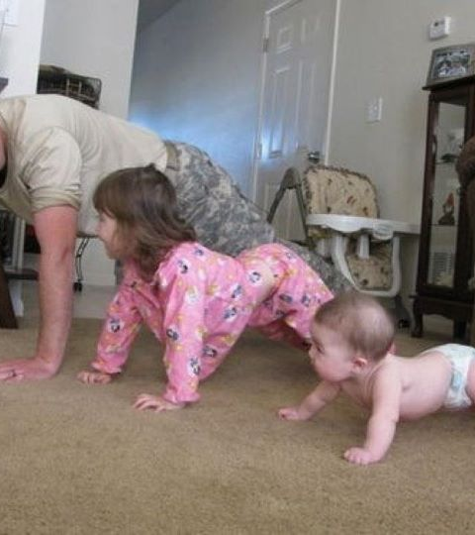
WordPress Basics

Slide 41
WordPress
A Content Management System (CMS) & Blogging platform.
One of the most popular platforms on the web.

Slide 42
Theme
Provide the look & feel and much of the functionality of your WordPress instance.

Slide 43
Plugin
Plugins extend and expand the functionality of WordPress.
Just under 50,000 to pick from. . .

Slide 44
WordPress Components
PHP Files
MySQL database

Slide 45
Do I need a local instance?
Great for testing out plugins before deploying them.
Great for learning.
Required if writing custom PHP code. ^{** very rare **}
Deploy content and layout pages directly in production

Slide 46
Create a Local instance
Get the Prerequisites
On Windows
https://webgallery.microsoft.com/apps/WordPress/install
WordPress, WebMatrix & MySQL
On Mac with MAMP
https://codex.wordpress.org/Installing_WordPress_Locally_on_Your_Mac_With_MAMP
Get the GiveCamp Distro of WordPress

Slide 47
What is in GiveCamp Distro of WordPress
WordPress 4.6
Divi Theme 2.7.10 **
https://www.elegantthemes.com/gallery/divi/documentation/
Plugins
Bloom - email opt-in plugin
https://www.elegantthemes.com/plugins/bloom/documentation/
Monarch – Social Sharing and Social Following plugin
https://www.elegantthemes.com/plugins/monarch/documentation/
Postman SMTP – for sending mail from your site
https://wordpress.org/plugins/postman-smtp/

Slide 48
Deploy GiveCamp Distro of WordPress
Create Database (aka Schema) in MySQL Locally
Unzip source
Open in WebMatrix
Run WordPress install Wizard
Set Divi Child as your default theme

Slide 49
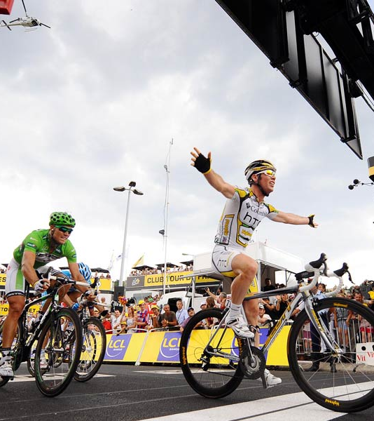
Tour de WordPress

Slide 50
Demo
Create WordPress Instance Locally
Create/Edit Page

Slide 51

Shawn’s Tips

Slide 52
Break the work into a few main goals
Overall Theme/Look and Feel
Home Page
About Us Page
Contact Us Page
Events Page
Blog
Etc…

Slide 53
Keep track of tasks
Know what you have to do, don’t get lost in the weeds
Post-its, Marker board, Digital Kanban board

Slide 54
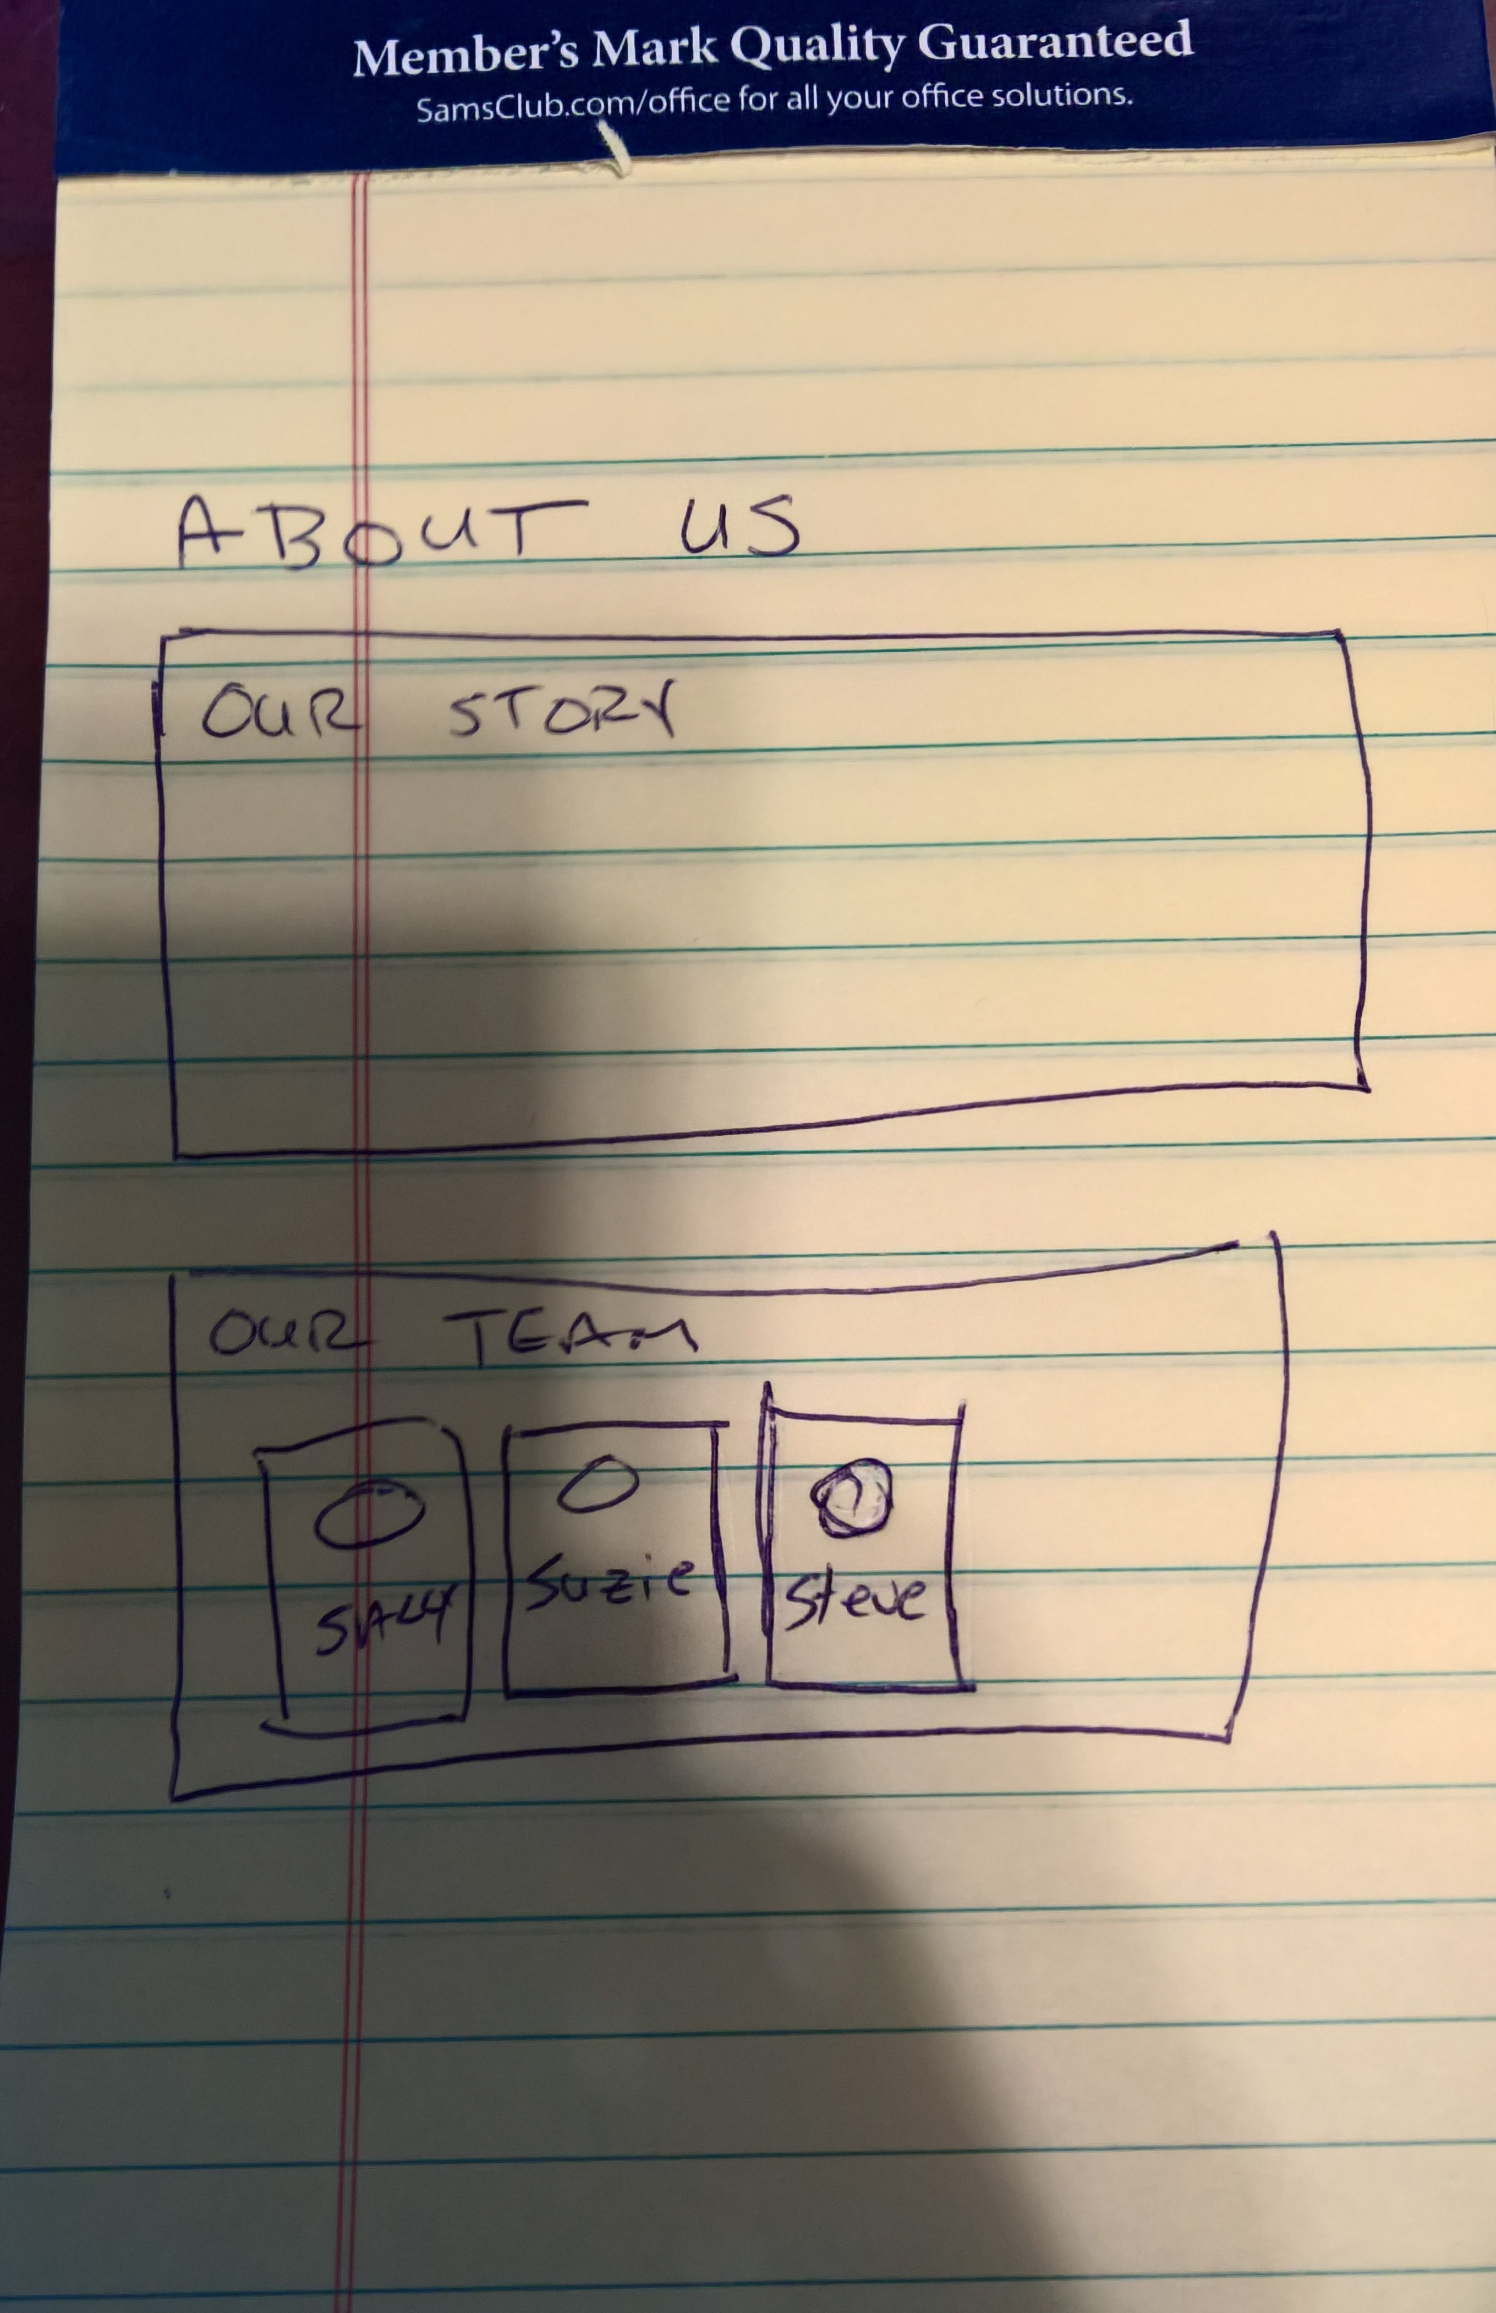
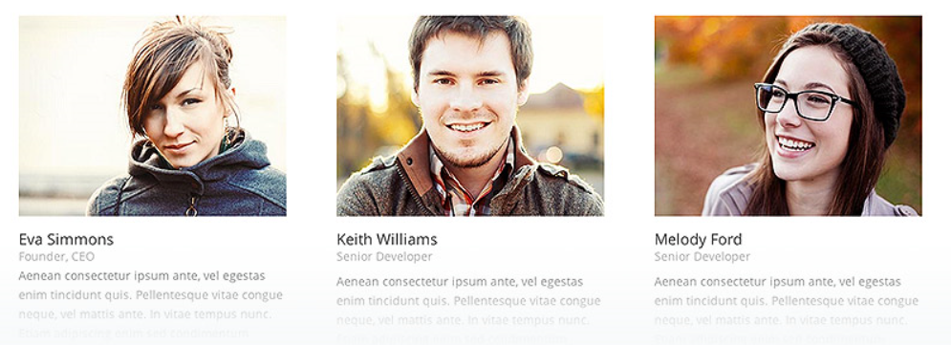
Decompose each into its parts
What parts of the page are static HTML Content?
What parts of the page require a plugin/module?
Divi Person Module

Slide 55
Can a Plugin Do it?
Before writing custom PHP code, review if a plugin can do what you need?
Plugins will be better tested and receive updates and bug fixes, your code will not.

Slide 56
Test Plugins
Test Plugins locally before deploying to production
Does it do what you need?
Is it easy to use/maintain?
Is it popular/recommended?
Look at scores/reviews in the WordPress Plugin Directory
Look for reviews comparing plugins by trusted authors

Slide 57
Can Divi do it?
Before installing a plugin, review if Divi can natively do what you want.
Every plugin you add
Increases your chances that the additional code will slow down the site
Increases your chances that there will be some strange interaction breaking things
Check out the Elegant Themes Blog: https://www.elegantthemes.com/blog/
Read/Review the docs: https://www.elegantthemes.com/gallery/divi/documentation/

Slide 58
Watch your URLs
Prefer relative URLs for local links over absolute
This will allow you to do a DNS Swing later and not break any links.
Watch your Images . . .

Slide 59
Is it Good Enough?
The requirements will ask for something.
There might be a popular plugin that does 90% of what the requirements are asking for…
Get the important work done and revisit less important hard things later.

Slide 60
Photos and Copyrights
Don’t use what you don’t have permission to use
Ensure that the charity is comfortable with the license of any code/photos you get from the web.

Slide 61
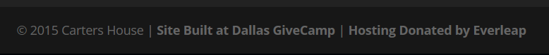
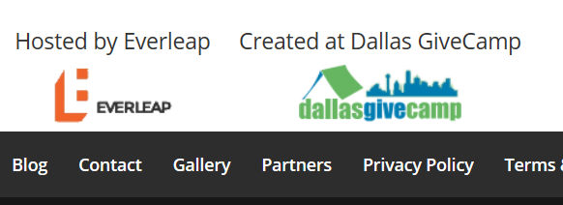
Give Thanks!
Attribute any work you are using appropriately.
Everleap Hosting

Slide 62
Before and After
Take pictures of the website before/after the weekend.
This will help with final presentations on Sunday.
Take backups of the website (code and database) before and after the weekend.
Talk to your Ninja, they might do this for you.

Slide 63
Keep the charity in mind!
The goal is not to demonstrate your technical prowess. The goal is to help the charity!
The charity will need to maintain this site going forward.

Slide 64
Share with your charity!
Document common scenarios
How to add an event
How to update a bio
Etc.

Slide 65
Get Help when you get stuck!
Search the web
Search the Tech Ninja/Tech Jedi Slack Channel
Ask your team
Ask a Tech Ninja/Tech Jedi

Slide 66


Slide 67
Q&A
?
Questions…

Slide 68
Thank you! Your Feedback is Important
Rate My Talk & Download Slides!
http://bit.ly/RateShawnsTalk
Contact Information
Email: shawn@shawnweisfeld.com
Blog: http://www.shawnweisfeld.com
Twitter: @shawnweisfeld

Slide 69

© 2016 Microsoft Corporation. All rights reserved. Microsoft, Windows, and other product names are or may be registered trademarks and/or trademarks in the U.S. and/or other countries.
The information herein is for informational purposes only and represents the current view of Microsoft Corporation as of the date of this presentation. Because Microsoft must respond to changing market conditions, it should not be interpreted to be a commitment on the part of Microsoft, and Microsoft cannot guarantee the accuracy of any information provided after the date of this presentation. MICROSOFT MAKES NO WARRANTIES, EXPRESS, IMPLIED OR STATUTORY, AS TO THE INFORMATION IN THIS PRESENTATION.

Slide 70
Key Dates
9/6/2016 Dev and PM Boot camp -6PM
9/21/2016 Kickoff – 6PM
9/30/2016 Start of GiveCamp - 5PM
10/2/2016 End of GiveCamp - 5PM
nThrive
5543 Legacy Drive
Plano TX 75024

Slide 71
Next Steps
Review and Get Familiar with your Handbook
Attend the Kickoff/Meet and Greet at nThrive scheduled for 09/21/2016 @6PM
Once assigned to a team, meet the Charity Reps and your Team Members. PMs Start planning and discussing requirements before the event.
Complete the Preparation Work outlined in the your Handbook leading up to the event. Email staff@DallasGiveCamp.org for any questions.
Have Fun!

